Slide 1
Module 28: Configuring Business Components and Fields
Siebel Core Developer and Technology School
Notes:
Time: Lecture: 20 minutes; labs: 20 – 30 minutes
Intent: To teach students how to edit the properties of business components and fields to capture business logic.
Flow: Describes how to edit business component properties to capture business logic, business component view modes, edit field properties to capture business logic, and specify business component and field user properties to extend their functionality.
Key Terms:
Owner Delete
Search Specification
Sort Specification
BusComp View Mode
Required Property
Read Only Property
Validation Property
Pre Default Value Property
Post Default Value Property
Calculated Value Property
Please note: Faculty-specific notes are italicized.

Slide 2

Module Objectives
After completing this module you will be able to:
  Edit business component properties to capture business logic
  Describe business component view modes
  Edit field properties to capture business logic
  Specify business component and field user properties to extend their functionality
Why you need to know:
  Editing the properties of business components and fields helps you to more accurately and fully capture your business logic

Slide 3
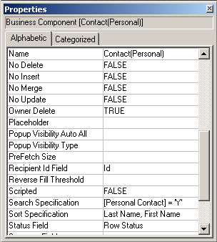
Business Components Properties
Capture business logic
Include:
  Editing properties
    No Delete
    No Insert
    No Merge
    No Update
  Owner Delete
  Search Specification
  Sort Specification
Notes:
This is a positioning slide. It provides an overview that highlights some important business component properties that are discussed in detail in this module.

Slide 4
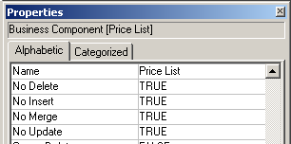
Properties for Editing
Set the editing properties at the business component level to prevent deleting, inserting, merging, and updating of records in all applets
Example: To maintain record continuity, users cannot delete or change price lists once they have been created
Notes:
The editing properties determine what operations are allowed on the business component records themselves.
Follow these steps to demo this:
Start Siebel Tools.
Select Business Component :: Price List.
Review the editing properties.

Slide 5
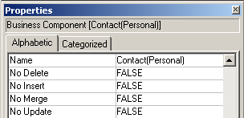
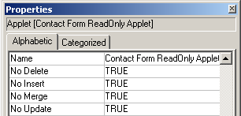
Properties for Editing Continued
These properties also appear on applets
  Most restrictive settings are always used
  Set these properties to FALSE at the business component level so that you can make exceptions at the applet level
Notes:
We usually choose to restrict editing at the applet level instead of the business component level. Then you can create special views that allow designated users with the right responsibilities to edit the records.
Now setting the Editing Properties of ‘No Delete’, ‘No Insert’, ‘No Merge’ and ‘No Update’ to True at the business component level means that all applets created for that business component will have to have these rules enforced upon them – there can be no exceptions. However, if there are some applets that you want to enforce these rules upon and some applets that you don’t, a way to overcome this is to set the properties at the applet level rather than at the business component level. This means that if you set any of the properties to true at the applet level, the rules are only enforced upon the applet that you set the property for – not the whole business component. Therefore you can analyze the need for these rules at an applet level rather than at a business component level, giving you greater flexibility.
One example of when you might want to enforce some editing rules is in the case of Personal Contacts. A user might want to edit their details, however in the Contact Form Read Only applet, you will probably want to stop the user from making amendments. This would be done by setting all the edit properties to True in the Contact Form Read Only applet and leaving them as False in the other applets relating to personal contacts.
One point to note is that you also have the option of setting these properties at an individual field level. This gives you further flexibility by allowing you to enforce rules on a field by field need.

Slide 6
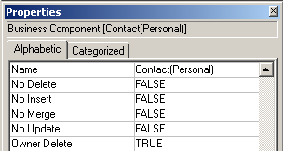
Owner Delete Property
Set the Owner Delete property to TRUE to enable only the owner of a record to delete it
  The primary on a team-based business component is the effective owner of the record
Notes:
Question: If Owner Delete is set to TRUE and No Delete is also set to TRUE, can the owner delete records?
Answer: No

Slide 7
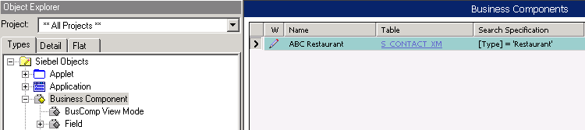
Search Specification Property
Specifies records to be retrieved by the business component
  Typically used when there are multiple business components on the same main table
Notes:
Now we will discuss the Search Specification property.
The Search Specification property in a business component, applet, link, or picklist selectively retrieves rows from the underlying table that meet the criterion specified in the property. The search specification is the basis for the WHERE clause in the resulting SQL statement. It acts like a predefined query controlling the data that is visible in the applet.
An index should be present that supports the search specification. Otherwise the RDBMS engine might scan through all rows in the table rather than only those to be returned by the query. This should be a single index which contains all the columns referenced by fields in the search specification.

Slide 8
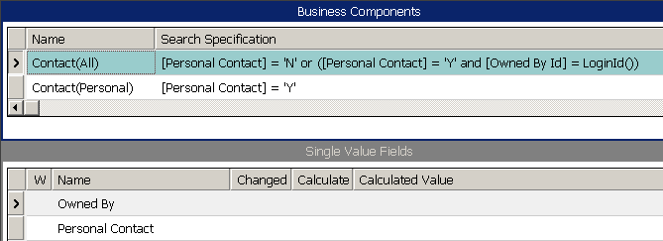
Search Specification Expression
May consist of field names, constants, functions, logical operators, and comparison operators
Example: For a given user, Contact(All) retrieves:
  All contacts where the Personal Contact flag is “N”
  All personal contacts belonging to the user
Field Name in [ ]
Operator
Logical Operator
Function
Must match exactly
Notes:
This slide shows the search specification for the Contact(All) business component. It is actually two specifications, joined with an OR.
The first search specification returns all contact records where the Personal Contact flag is set to “N” (they are not personal contacts).
The second returns all contact records where the Personal Contact flag is set to ‘Y’ (the contact is a personal contact) and the owner of the record matches the login ID (it is a personal contact for the current user).
Because the two specifications are combined using OR, any record that meets either specification is returned.

Slide 9
Search Specification Considerations
These business component properties also appear on Applets
Search Specifications are joined with an AND in business components and applets in the generated SQL statement
  Predefined queries may also contribute to the WHERE clause
Avoid mutually exclusive search specifications
UI
Layer
List Column
or Control
Applet
View
Screen
Application
Business
Layer
Field
Business
Component
Business
Object
Notes:
You can set a search specification at the applet level as well. Position determines which records you have access to. Personalization rules also control the records you see based on certain criteria. For example, if it is Groundhog Day, you might see only the price lists with the Groundhog Day specials included.
The property text is limited to 255 characters for Sort Specification, Search Specification, and Validation properties.
Search specifications manifest as part of the WHERE clause for all applets that display this business component.
Applet, position, and personalization criteria can also become part of the WHERE clause, as well as predefined queries (PDQs).
All of these are connected together with AND. Therefore, if any of these create mutually exclusive criteria, then no records can be displayed.
Single versus double quotes in the search specification for a business component: 77% of the time we use single quotes. The ratio stays about the same regardless of whether we're quoting a single character or multiple ones.

Slide 10
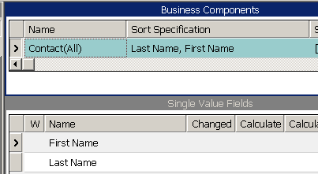
Sort Specification Property
Determines the sort order of the retrieved records
  Use (DESC) or (DESCENDING) to sort that field in reverse order
  Cannot be set at the applet level
Field Name or Names, no [ ]
Comma separated
Must match exactly
Notes:
The Sort Specification property of a BC orders the records retrieved by a query, and serves as the basis for the ORDER BY parameter in the SQL statement issued. The value of the Sort Specification property is the name of a field or list of fields which must be child objects of the BC. It sorts the records returned to an applet associated with this BC.
Example: The Sort Specification of the Account BC is “Name, Location.” This causes account records to be sorted by account name. Where multiple records have the same account name, they are sorted within Name by location. Observe the following syntax considerations:
Use commas to separate field names in a sort specification.
To indicate that a field in the list sorts in descending order, include
(DESCENDING) or (DESC) after the field name, as in “Start Date
(DESCENDING).” If you do not specify a sort order, ascending order is used.
Do not enclose the field name in square brackets, like this: [Account
Name]. Brackets are accepted in search specifications, but not sort
specifications.
The Sort Specification expression must be 255 characters or less.
If the Sort Specification value is blank, the Siebel application returns
records in the order in which they occur in the table.
When a check box field is included in a sort specification, three values are sorted: Y, N, and NULL. If the sorting is in descending order, the order is NULL, Y, and N.
When a multi-value field is included in a sort specification expression in a BC, the sorting is on the initial value of the multi-value field. This makes sense only if the multi-value group uses a primary foreign key.
A sort specification that includes a multi-value field in the expression does not sort the records in the underlying multi-value group. Instead, you create a sort specification in the detail BC of the multi-value link to do this.

Slide 11
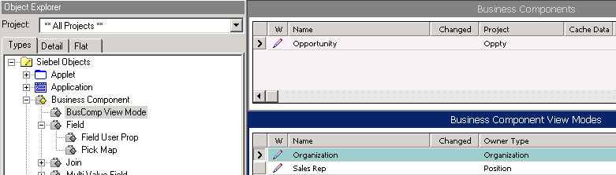
BusComp View Mode
Is a child object type of business component that specifies the business component is subject to access control
  Owner Type property identifies the Access Control mechanism that limits records a user can access
Business components may have multiple access mechanisms
  Allows records to be associated with different owner types
  Supports multiple view modes
Example: Opportunities may be owned by Positions and Organizations
Notes:
BusComp View Modes must be configured for visibility if they are to be displayed in views such as the My, My Team’s and All views discussed in the Access Control modules.
The BusComp View Mode child object definition specifies the type of access control (e.g., Person, Position or Organization) and the field containing the owning person, position, or organization.
If the Access Control field is single-valued, the field name is specified in the Visibility Field property. If the Access Control field is multi-valued, the field name is specified in the Visibility MVField, and the multi-value link used by the Visibility MVField is specified in the Visibility MVLink property.
Views also require configuration for Access Control.
For more information, consult the Security Guide for eBusiness Applications.

Slide 12
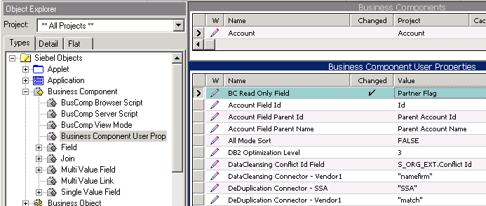
Business Component User Prop
Is a child object type of business component used to configure additional behavior for the business component
  Enables configuration not handled through properties of the business component object definition itself
Can be added during configuration by developers
  For example: To configure data-driven, read-only behavior
User property that makes a record read-only if the Partner flag = TRUE
Notes:
The Business Component User Prop object definition contains user properties, which specify additional functionality for Business Components that is not captured in the Business Component object type.
The example in the slide shows a user property called BC Read Only Field. This is not part of the Account business component, but is shown as an example. The Value of BC Read Only Field specifies the name of the field that would make the Account business component conditionally read only.
In this example, if the Partner Flag were set to True on a record in the Account business component, that record would be read-only. Another record in the Account business component that had the Partner Flag set to False would not be read-only.
A list of User Properties is contained in the Siebel Developer’s Reference in Bookshelf.

Slide 13
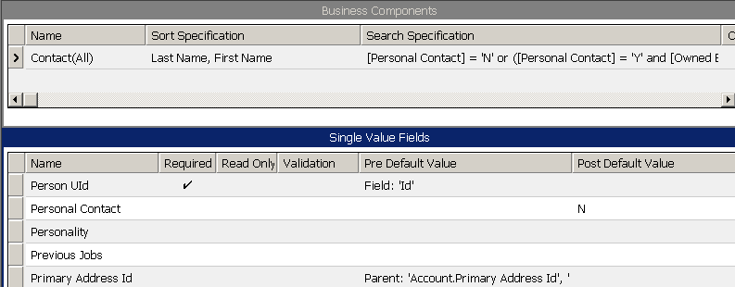
Field Properties
Customize fields by editing property values
Setting field properties at the business component level sets them across all applets
Notes:
This is a positioning slide. The following properties are handled in depth in the next few slides.
Required
Read Only
Validation
Pre Default Value
Post Default Value
Calculated fields are also discussed in this module, and use the properties “Calculated” and “Calculated Value.”

Slide 14
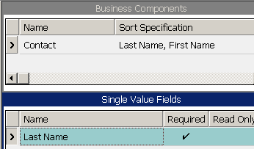
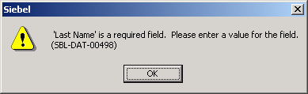

Required Property
Set the Required property to TRUE to prevent user from leaving field blank
Example: Contacts require last names
Attempting to save without a last name causes an error message
Required fields in forms are marked with asterisks (*)
Notes:
The required property ensures that a user must provide a value for the field before the record can be saved. On the other hand, if the field has a pre-default value, as shown on slide 18, the user can simply accept the default.
Discuss the implications of making this field required at the Business Component level, for example:
Any control based on this field in any applet will now require a value.
Also, if you were to import data into the application through the Business Objects layer (for example, using EAI or a programmatic interface), then you would have to ensure that the record had a value for this field, otherwise the record would be rejected.

Slide 15
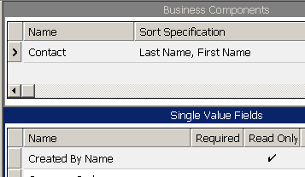
Read Only Property
Set the Read Only property to TRUE to prevent user from editing the value
Read only on all applets
Notes:
The read only property prevents users from editing the field, regardless of the applet. If you want the user to be able to enter a value for this field when creating a new record, do not set this property to True.
Controls and List Columns can also be set to Read Only. This property can be used to make the field to be read-only in one applet, but editable in another. Discuss the implications of making a field read-only at the Business Component level as opposed to the Applet level.

Slide 16
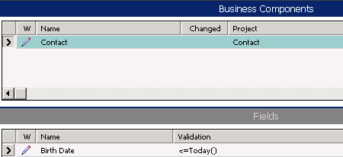
Validation Property
Create a Validation property to ensure that field data is valid
  Rule is checked when you save the record
Birth date must be
prior to the current date
Notes:
Validation property defines a condition that must be TRUE for the user to be able to exit the field. If it is not, the application automatically generates a message for the user.
A field’s Validation property restricts the values for a field or ensures the correctness of data entered for a single-value field. Validation is not supported for MVFs.
The property text is limited to 255 characters for Sort Specification, Search Specification, and Validation properties.

Slide 17
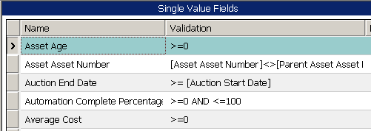
Validation Property Continued
Is expressed as a combination of logical operators, constants, field names, and predefined functions
Can refer only to business component fields in the same record
Constant
Field name
Logical Operator
Operator
Notes:
These are examples of what can appear in a validation expression. Note that the expression can refer to other fields in the same business component. It can also refer to fields in the parent business component as long as the parent business component is part of the current view.

Slide 18
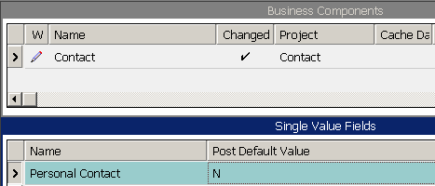
Default Values for Fields
Pre Default Value
  Automatically assigns a value to a field for a new record
Post Default Value
  Assigns a value to a field, if not entered by the user, before the record is inserted into the database
Example: If the user does not designate a contact as personal, the system assumes it is not
Notes:
The Pre Default property defines a value that is automatically assigned to the field when a new record is created.
Pre Default values are common in a number of situations. For example, they can be used to fill in fields that are used to distinguish between records for different business components that use the same table. For example, the Contact(Personal) business component uses the same tables and columns as a number of other business components including Contact, Contact(All), and Contact(Purchasing Manager). However, it pre defaults the “Personal Contact” field to ‘Y,’ which differentiates it from other contact-type business components.
Pre Default values can be used to automatically fill in parent-related fields when creating a record in the child business component in a detail view. They are also used when there is a field with an obvious value, like a date field.
Follow these steps to demo this:
1. Navigate to the Service Request List applet.
2. Add a new SR. Note that the SR Number, Priority, and Status fields are automatically given a value. These fields have had a Pre Default value set at the field level in Siebel Tools.
The Post Default property defines a value that is assigned to a field when a user saves a record but has not provided a value for that field.
Follow these steps to demo this:
1. Navigate to the Opportunity-Quote view.
2. Add a new quote but do not put a value in the Name field.
3. Save the record. Note that the quote Name field now has a value. This was added when you saved the record; a post-default value was set at the field level for this to occur.

Slide 19
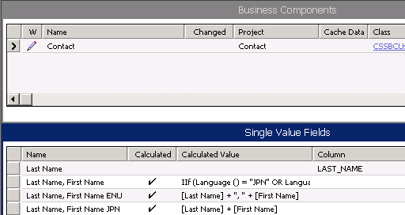
Calculated Fields
Derive their value from the values in other fields of the business component
Cannot be stored in the database; therefore, there is no associated column
Require setting the Calculated property to TRUE (shown as check mark)
Column property
is empty because
calculated fields are not
stored in the database
Notes:
This slide explains what a calculated field is.
A calculated field is one whose value is derived from some formula involving other fields. You do not enter data into a calculated field; the system automatically determines the correct value.
The calculated flag must be set to TRUE.
A calculated field in Siebel Tools is implemented by the specification of a Calculated Value property value in a Field object definition. The Calculated Value property specifies an expression for calculating the value of a field. The syntax for the Calculated Value or Validation property is the same as the QBE syntax, with different but overlapping functions. The comparison, logical AND, and logical OR operators are valid for these properties.

Slide 20
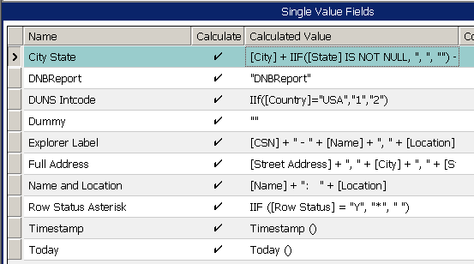
Calculated Value Property
Is an expression built from:
  Field names in the same business component
  Field names from the parent business component
    Current business component must have the child in a detail view
  Standard functions
  String, numeric, and logical operators
System functions
Notes:
This slide explains what can appear in an expression for a calculated value. The syntax for the Calculated Value or Validation property is the same as the QBE syntax, with different but overlapping functions. The comparison, logical AND, and logical OR operators are valid for these properties.

Slide 21
Restrictions on Calculated Fields
Calculated fields are read-only
System does not validate values of calculated fields
Sorting on calculated fields is not supported
Querying on calculated fields is supported
  Performance depends upon whether the functions in the query expression can be incorporated into the SQL statement
Notes:
Calculated fields have the following rules and restrictions:
Calculated fields do not support updates (even simple
expressions like [Field]), unless specialized business
components override SqlSetFieldValue.
Calculated fields cannot be stored in columns.
Validation criteria on calculated fields is ignored.
Queries on calculated fields are always supported.
Sorting on calculated fields is never supported.
Calculated fields are not stored in tables.
When a query is performed on a calculated field, the action taken by the Siebel application (and thus the resulting performance) depends on which functions are used within the calculation. Functions that can be incorporated directly into the WHERE clause in the SQL statement are incorporated. Functions that cannot be directly incorporated, such as If() and Lookup(), result in testing each record in the business component to determine which records to display to the user, at a considerable performance cost.
Performance considerations for Calculated Fields
Avoid calculated fields that are not supported by the RDBMS
Querying on calculated fields is supported
Performance depends upon whether the functions in the query expression can be incorporated into the SQL statement
Avoid totaling values unless number of records will always be small

Slide 22
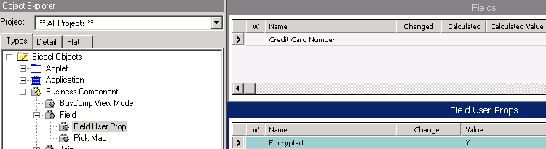
Field User Prop
Is a child object type of Field used to configure additional behavior for the field
  Enables configuration not handled through properties of the Field object definition itself
Can be added during configuration by developers
  For example: To encrypt a field
Notes:
The Field User Prop object definition contains user properties, which specify additional functionality for Fields that are not captured in the Field object type.
The example shown in the slide is a user property called Encrypted. This user property causes the value of the field to be encrypted before it is stored in the database. This is especially useful for sensitive data such as credit card numbers and social security numbers.
An example of an encrypted field can be found on Business Component :: Quote | Field :: Credit Card Number | Field User Prop.
Encrypted field functionality uses several field user properties, including Encrypted (set to Y for encrypted fields), Encrypt Service Name (set to the name of the business service performing the encryption, such as the RC2 Encryptor), Encrypt Key Field, (set to the name of the field where the business service will store the encryption key it generates), and Encrypt ReadOnly Field (set to the name of the read only field, which is displayed to the end user). The combination of these user properties makes a field encrypted. More detail on encrypted fields can be found in the Security Guide for eBusiness Applications in Bookshelf. More detail on Field User Props can be found in the Siebel Developer’s Reference.

Slide 23
Modifying a Field - Example
Scenario:
We were asked to modify the Owned By Id field on the Service Request business component. They asked us to add the Creator Id field as a default value.
Notes:
In this example, we were asked to modify the Owned By Id field on the Service Request business component. They asked us to add the Creator Id field as a default value.

Slide 24
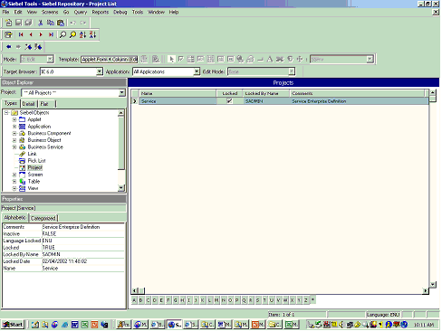
Modifying a Field - Example
In Siebel Tools/Object Explorer, select Projects definition.
Make a query by the Service project and lock it.

Slide 25
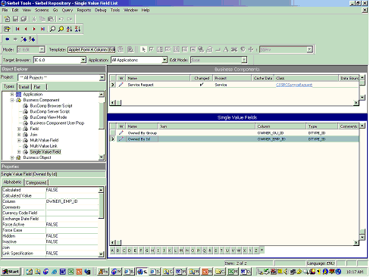
Modifying a Field - Example
In the Object Explorer, select Business Components definition.
In the Business Components applet, make a query by Service Request.
In the Object Explorer, expand the Business Components definition and select Single Value Field.

Slide 26
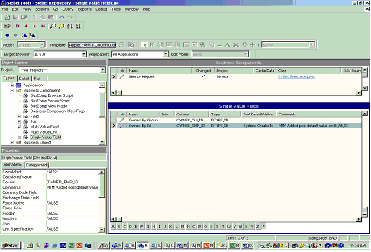
Modifying a Field - Example
In the Single Value Field Applet, make a query by Owned By Id field.
Set Post Default Value = System: CreatorId (Do not include the equal sign, “=“).
Add the following Comment: “Your initials” added post default value “Today’s Date”

Slide 27
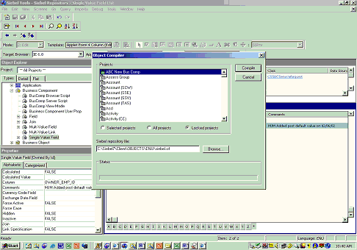
Testing your changes - Example
Compile your changes.
- Go to Tools/Compile Projects
- Add the Siebel Repository File: C:\Siebel7\Client\OBJECTS\ENU\siebel.srf
- Click Compile

Slide 28
Summary
This module showed you how to:
  Edit business component properties to capture business logic
  Describe business component view modes
  Edit field properties to capture business logic
  Specify business component and field user properties to extend their functionality
Notes:
Review Question: If you give the same field a pre-default value and a post-default value, will the post-default value ever be used for anything?
Answer: Yes, if the user creating the record deletes the pre-default value but does not give it a new value, the post-default value will be automatically filled in.

Slide 29
Lab
In the lab you will:
  Incorporate business logic into the application by configuring properties of business components and fields
Notes:
See the lab instructions for details.

